Slide 1
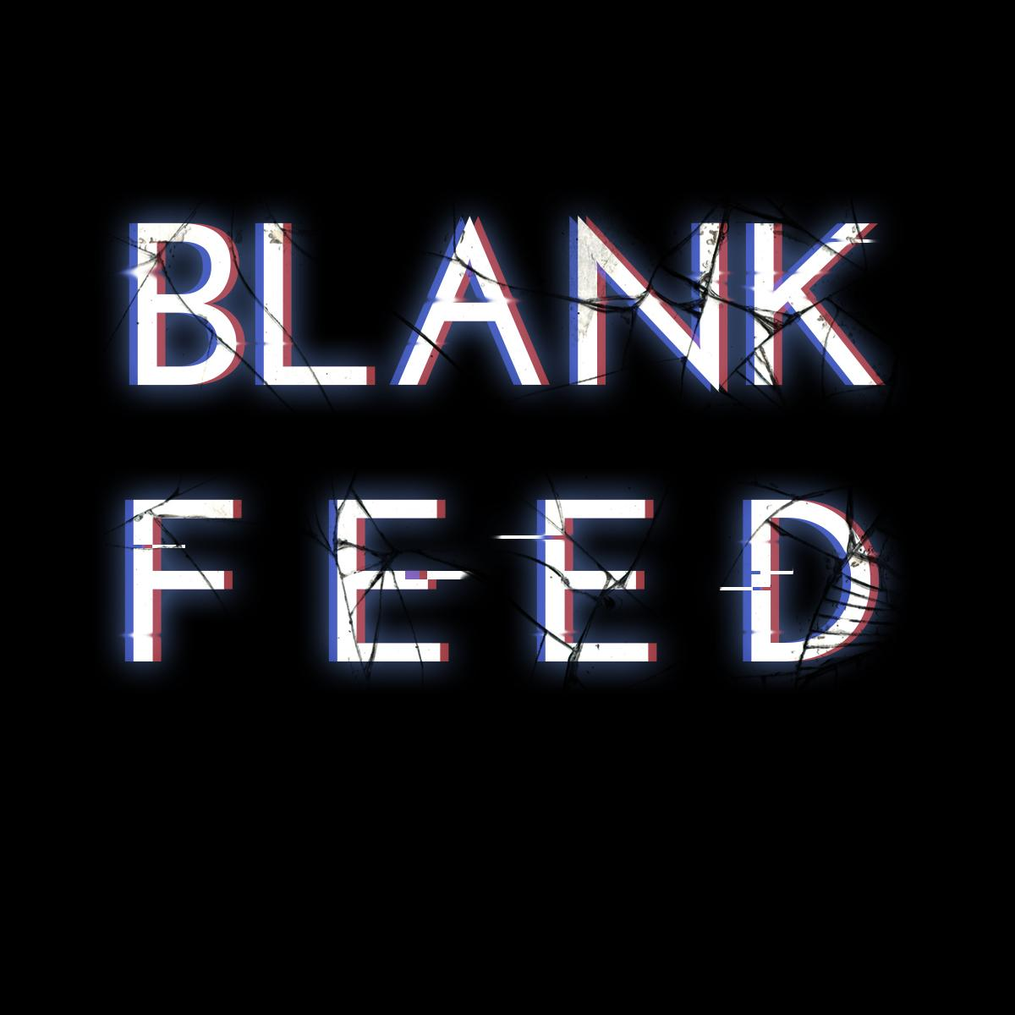

Slide 2
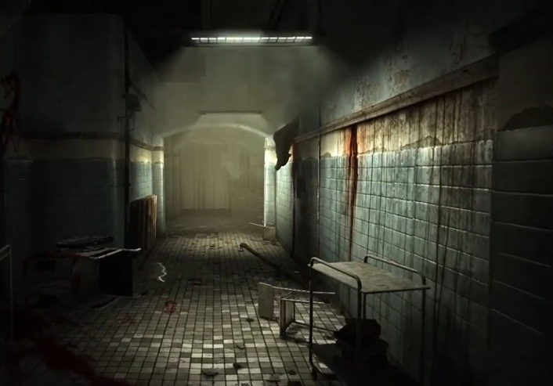
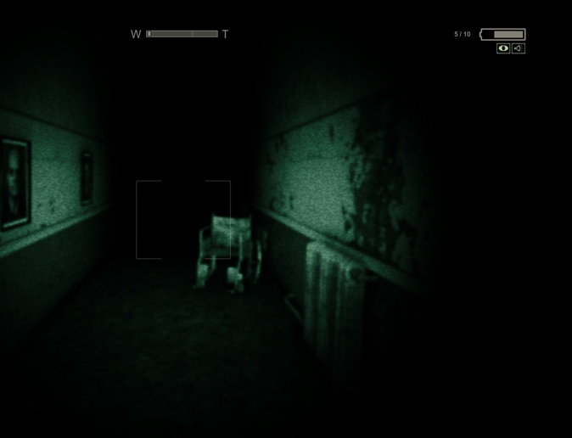
The Game
Blank Feed
Blank Feed is a 1st person puzzle horror game that utilizes the security camera point-of-view of Five Nights at Freddy’s with the survival horror and environmental puzzles of old school Resident Evil (0-3, Veronica). You take on the role of a young woman trapped in an abandoned underground science facility. You must use security cameras to plan your route, solve puzzles, and avoid the creatures that stalk the halls, to have any chance of making it out alive.

Slide 3
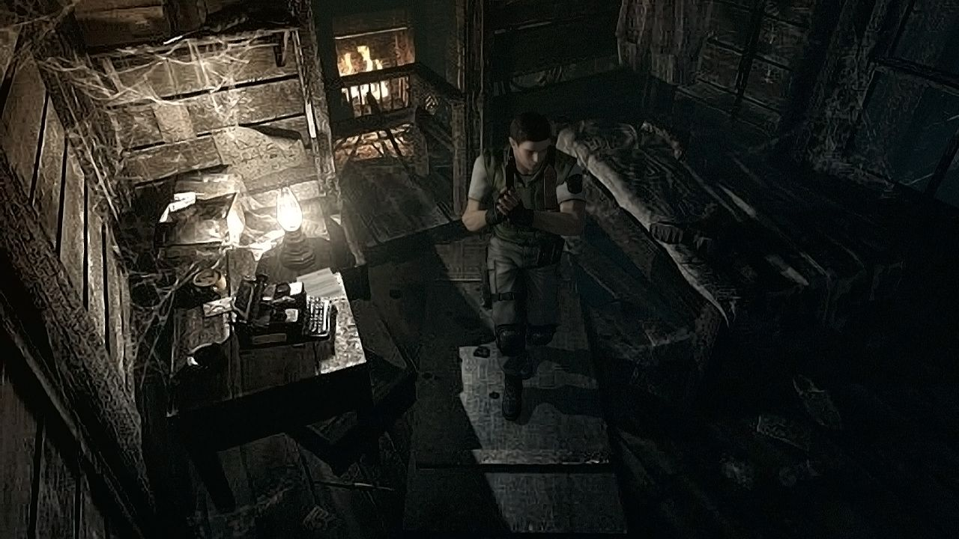
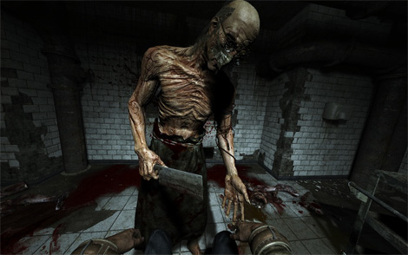

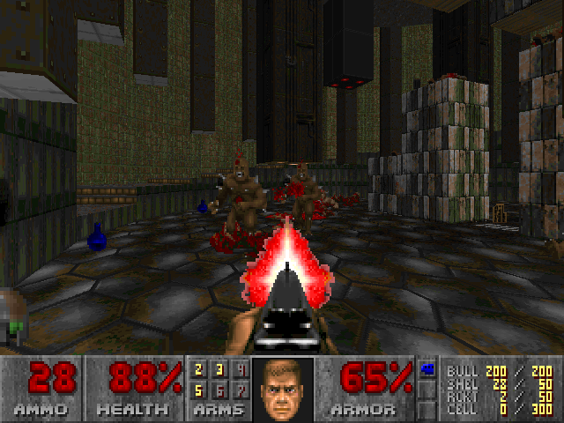
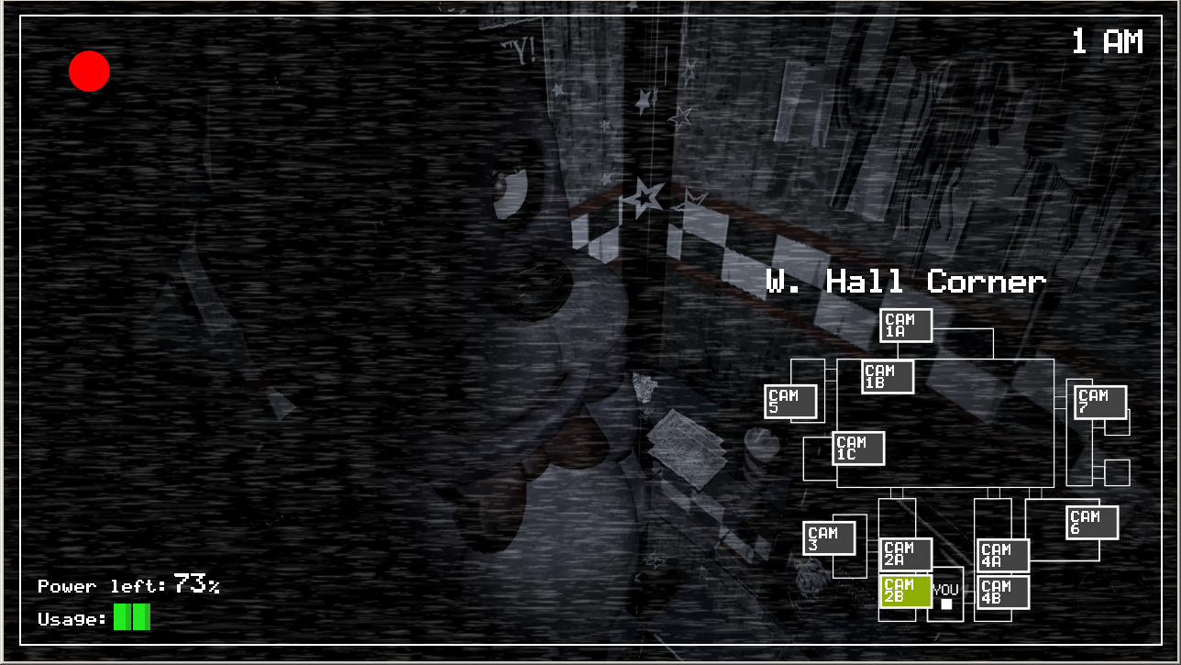
Art Style Spacegraph
Blank Feed
High Detail
Realism
Stylized
Low Detail

Slide 4
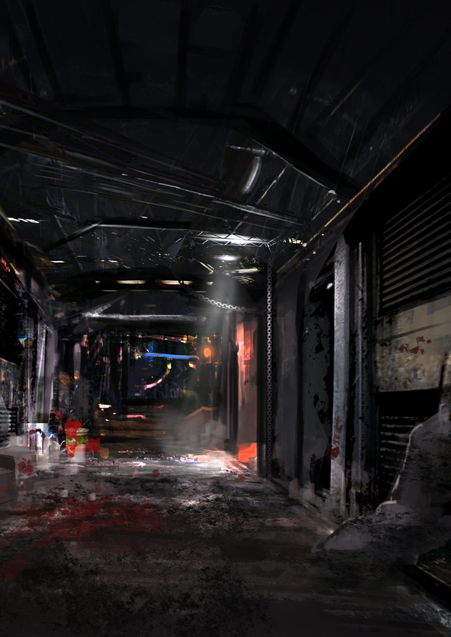
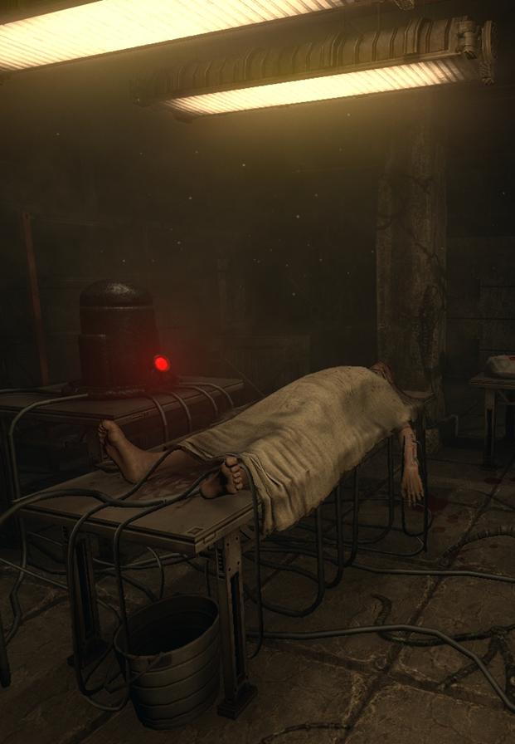
Target Goal
Blank Feed

Slide 5
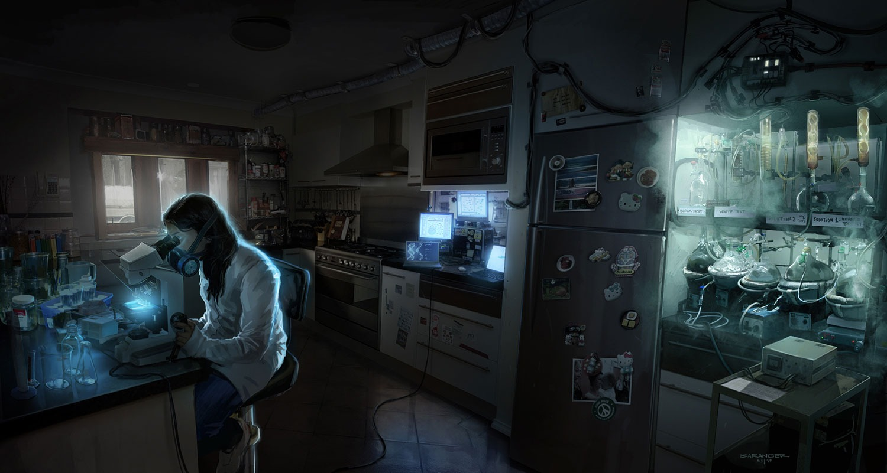
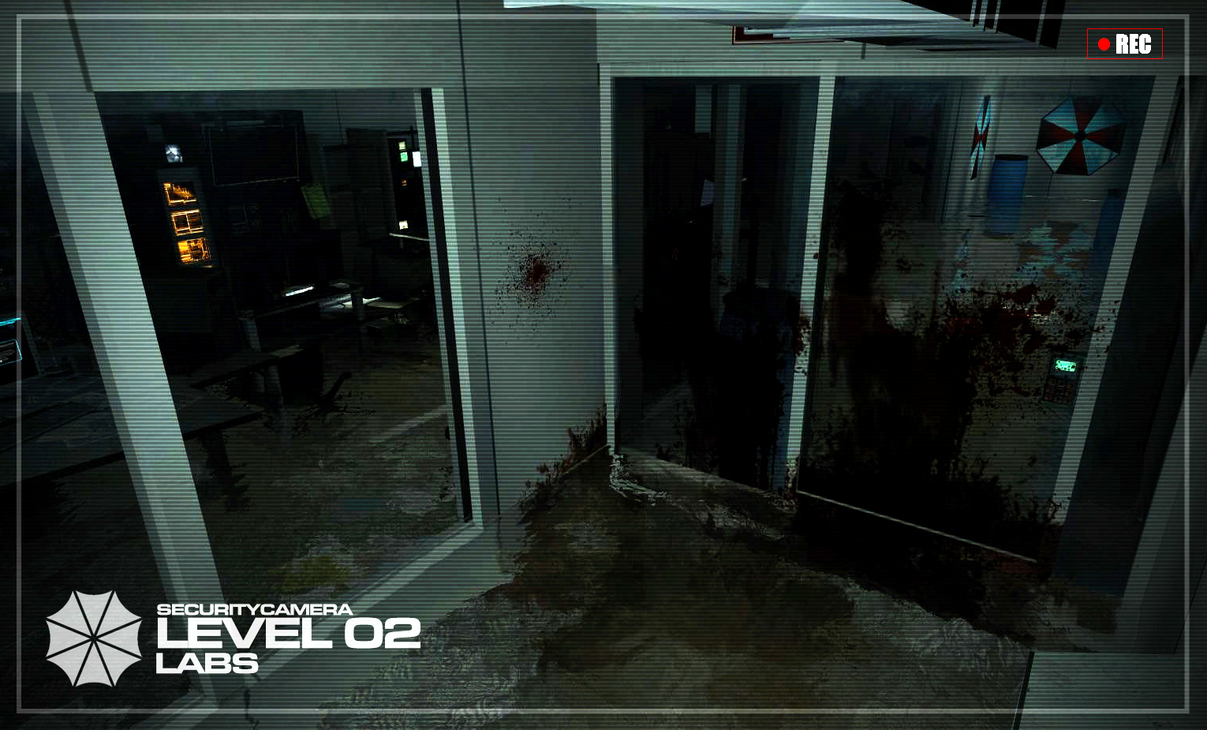
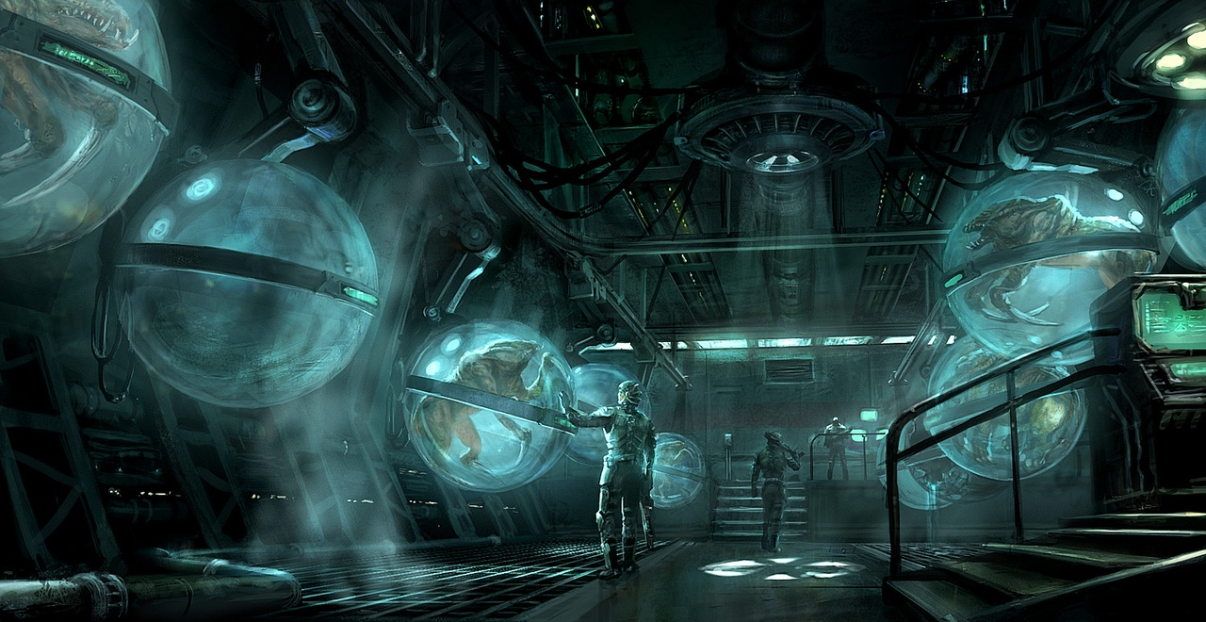
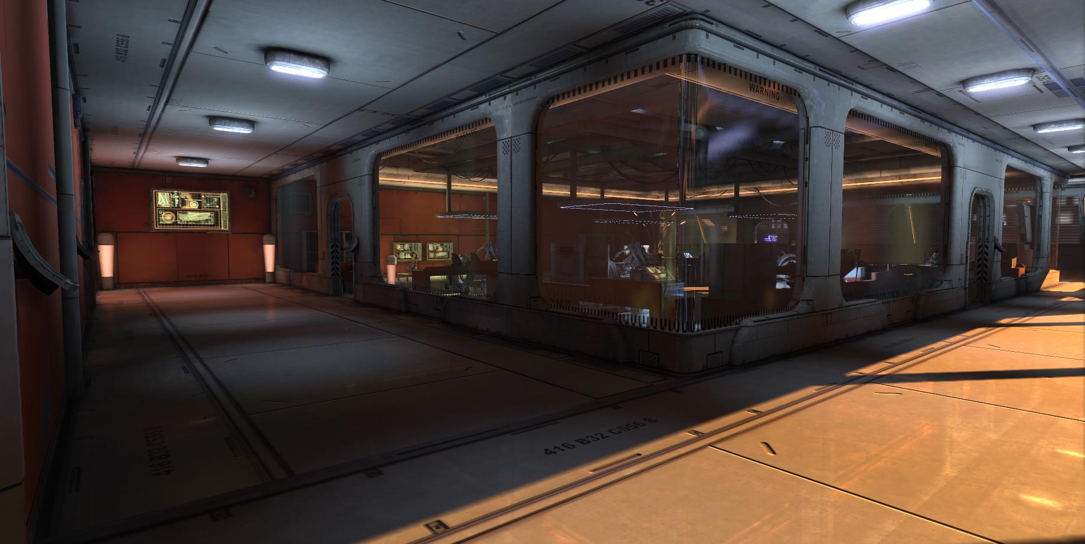
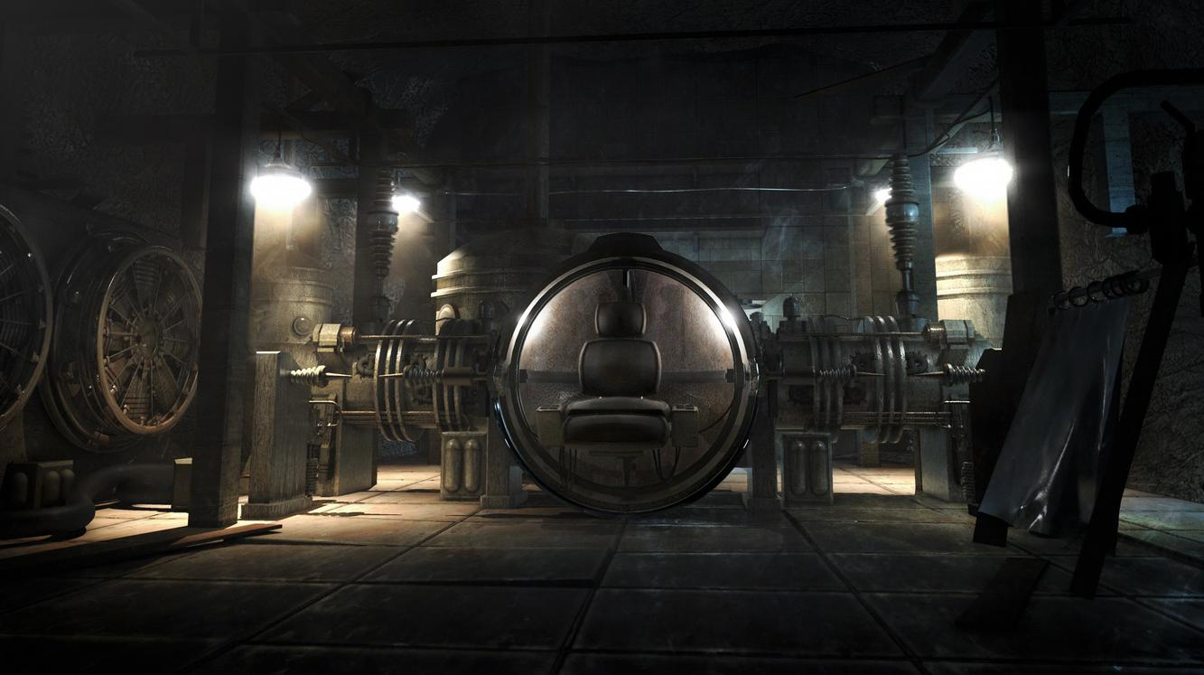
Environment - Lab
Blank Feed

Slide 6
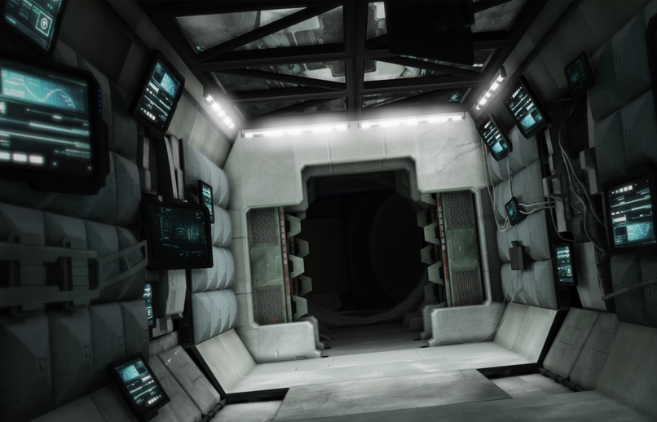
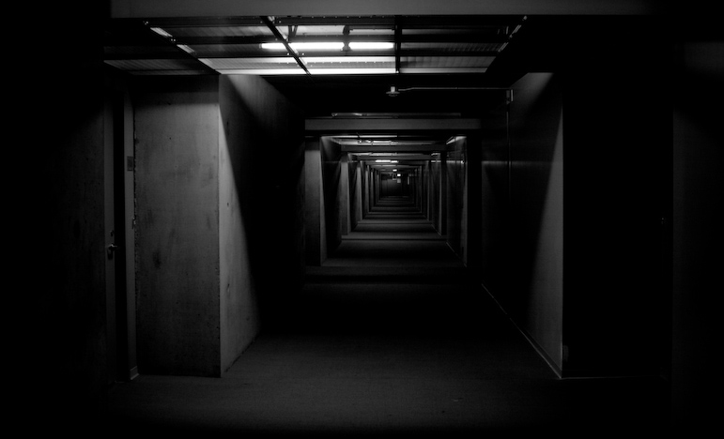
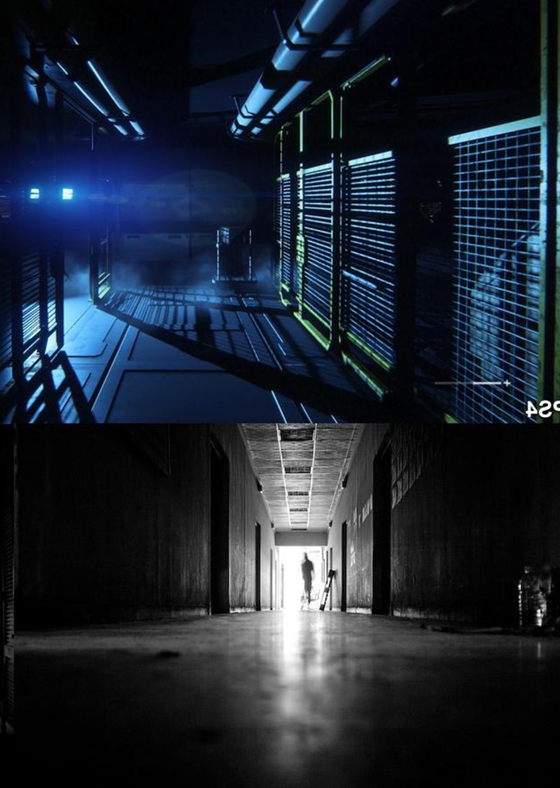
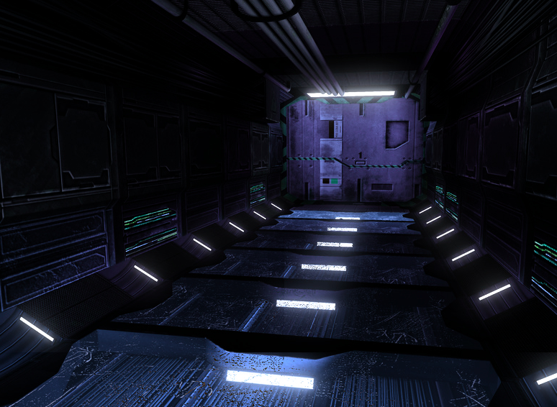
Environment - Hallways
Blank Feed

Slide 7
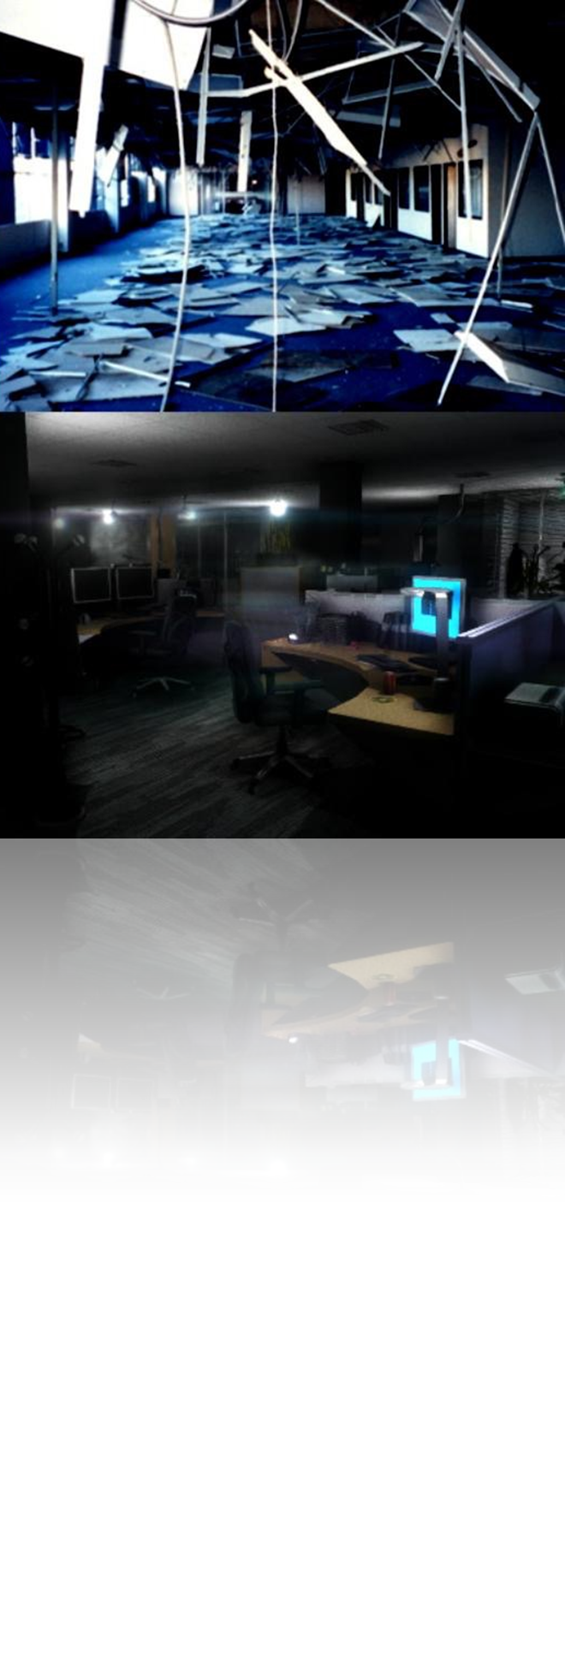
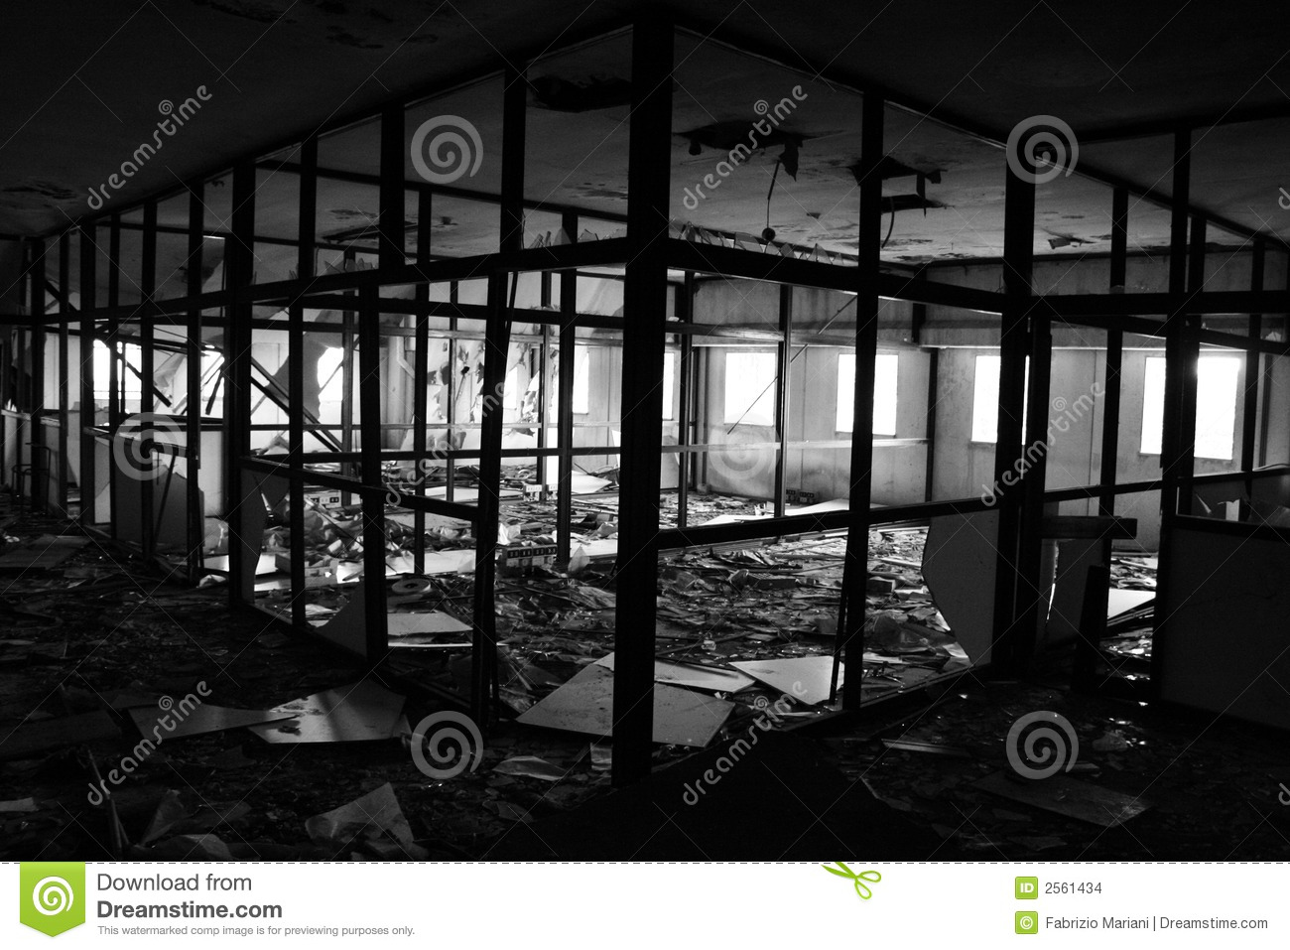
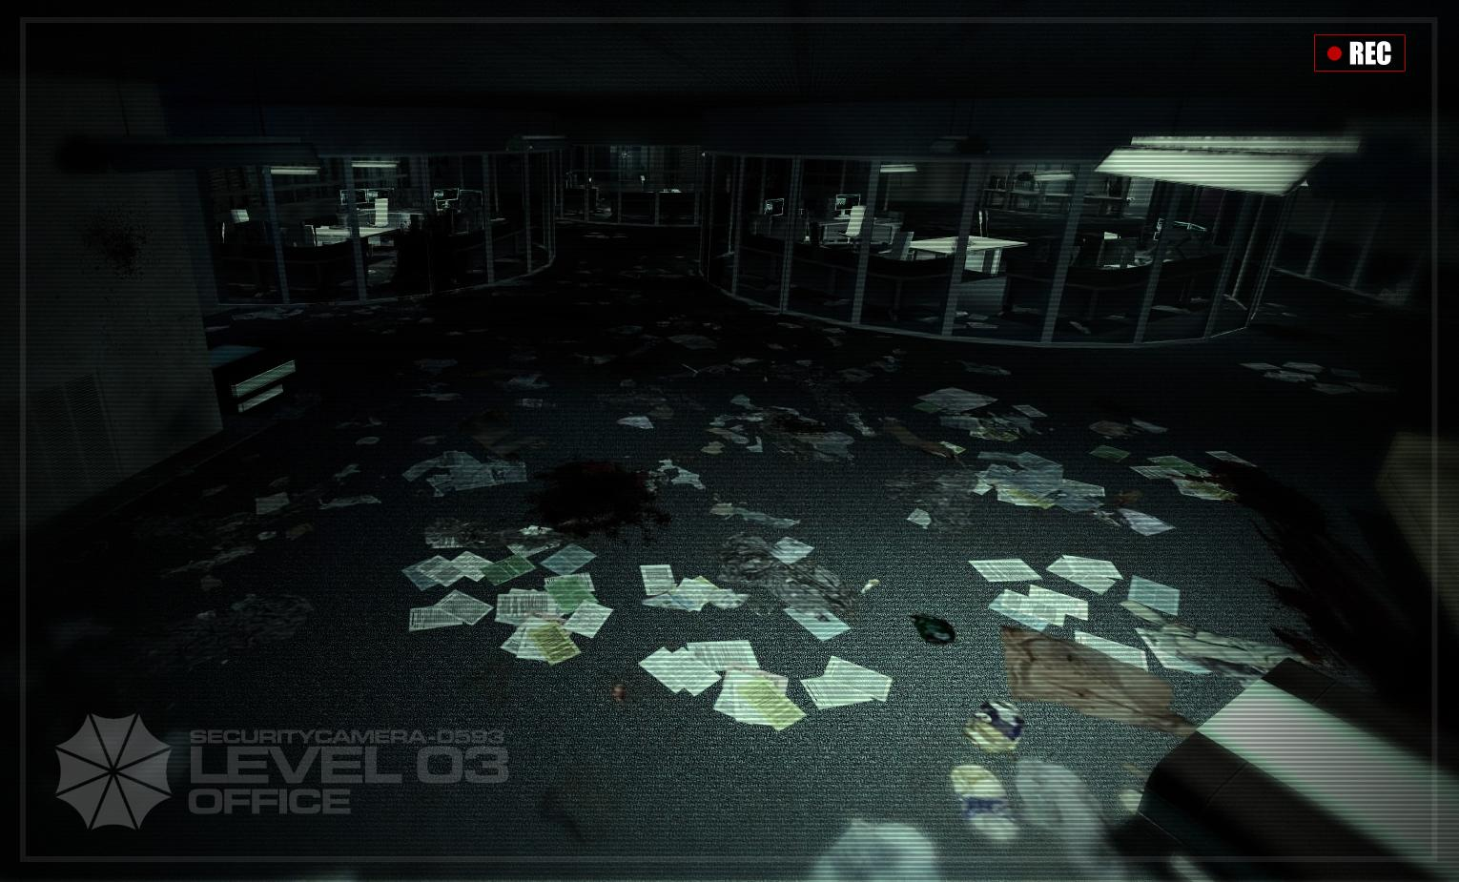
Environment - Offices
Blank Feed

Slide 8
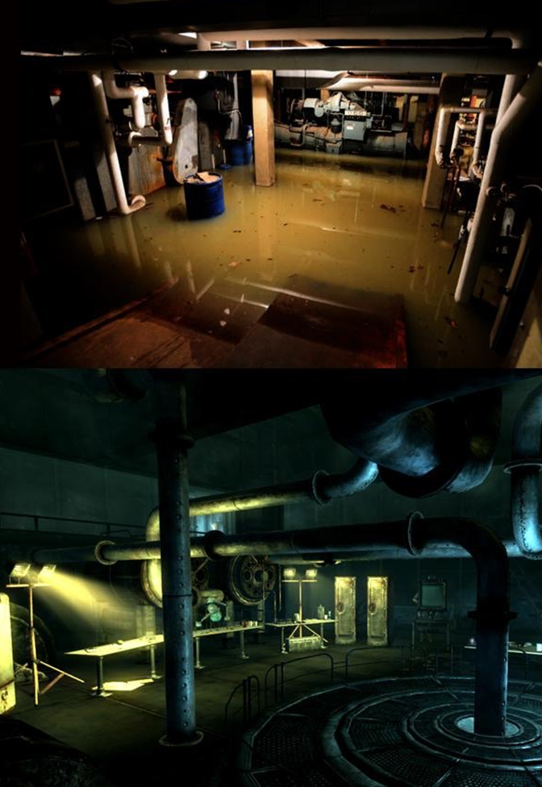
Environment -
Maintenance Area
Blank Feed

Slide 9

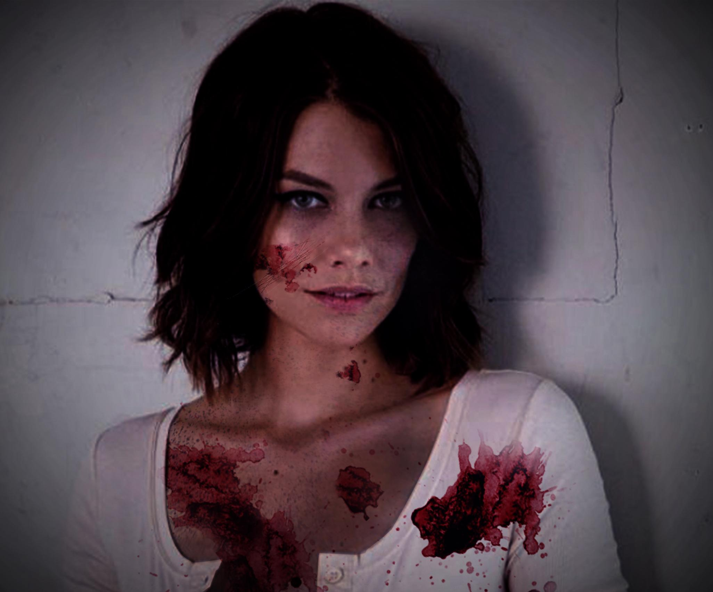
Character Concept
Blank Feed

Slide 10
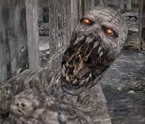
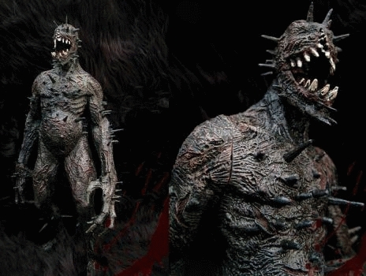
Creature Concept
Blank Feed

Slide 11
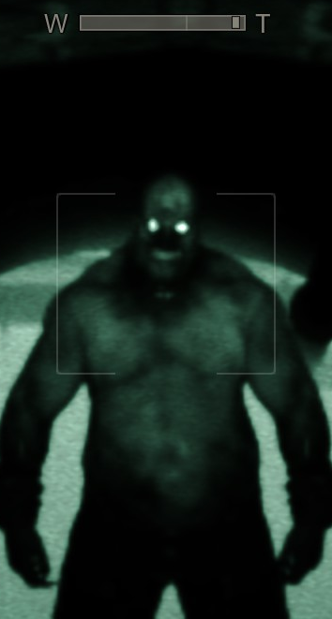
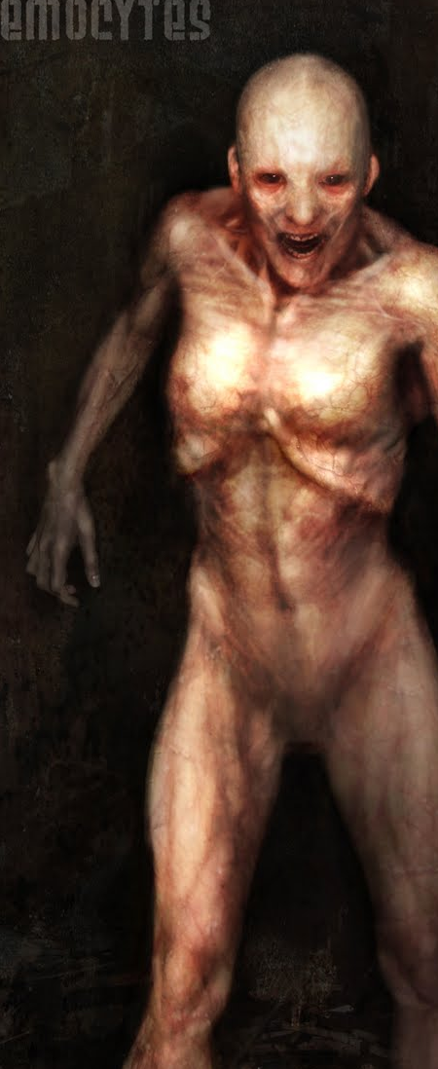
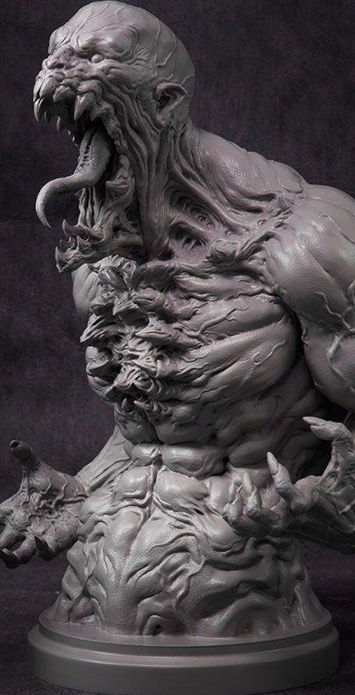
Creature Concept
Blank Feed

Slide 12

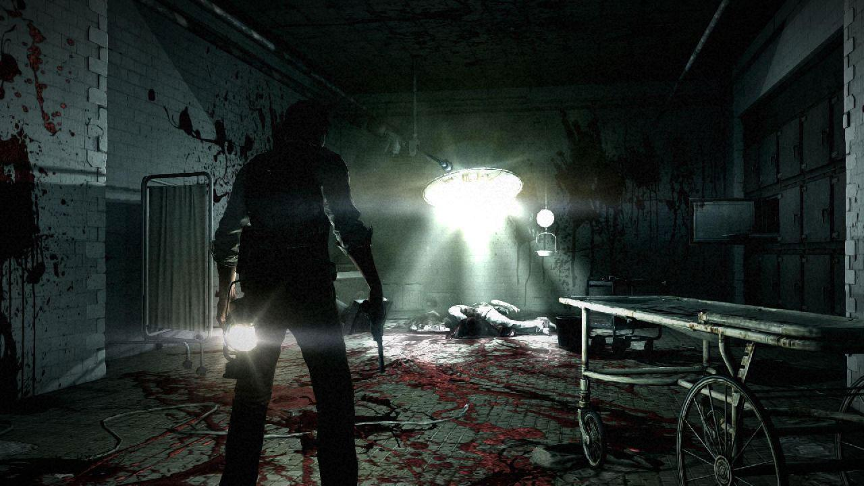
We have room for you
Blank Feed
Modellers
Female Human Model
Horrific Monster(s)
High-tech sci-fi equipment (ie. things to grow monsters in)
Environment
Riggers
Human protagonist
Monster
Animators
Human protagonist
Monster
Texture Artists
Human protagonist
Monster
Environment props

Slide 13

The Software
Blank Feed
AAA Quality
Free
Recognized by Market

Slide 14



















The Software
Blank Feed

Slide 15
The Software
(Play video)
Blank Feed

Slide 16
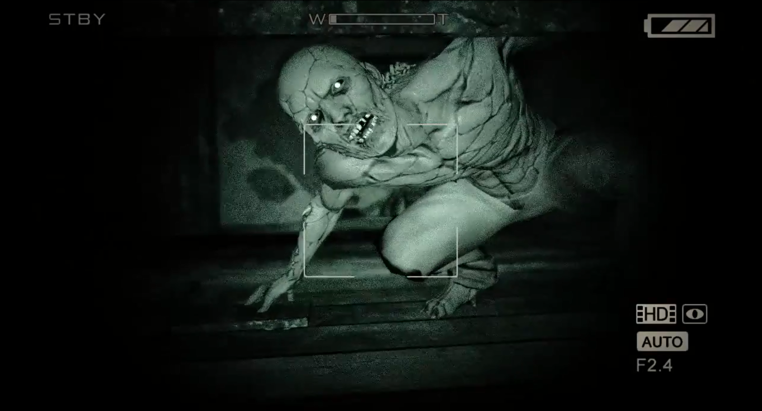
Why would you join us?
Blank Feed

Slide 18
Game Setting - (Part we pitch)
Blank Feed’s setting can be broken down into 4 parts: Laboratories, Hallways, Offices, and Maintenance Areas. Each have their own unique look and feel to them.
Laboratories
Labs have a sterile and minimalistic feel about them, which is juxtaposed against the blood and gore that paints the walls. Labs, being self contained areas, are built differently from the rest of the building. Many of the labs are made from thick transparent glass walls, which give them both a claustrophobic, and exposed feeling. The claustrophobic feeling comes from there being only one entrance/exit to the room, combined with the ever present feeling of something drawing onto your position. Lab equipment varies from lab to lab; all weaving a subtle backstory to how these creatures that stalk you, came to be.

Slide 19
Game Setting - (Part we pitch)
Hallways
Hallways connect all the different locations of the facility, and are the primary way you get around.
Hallways are designed to be efficiently narrow. They contain lots of side pockets to add tension and uncertainty. Much of the lighting is lit from ground level, casting subtle shadows upward onto objects. This gives anything in the area a partial silhouette look. Like everywhere in the facility, subtle gore paints the area, giving an implied backstory to what happened in the facility.

Slide 20
Game Setting - (Part we pitch)
Offices
Having the most objects in them, offices tend to be the most destroyed looking areas. Desks and wall dividers are knocked about, blocking paths, which turns the space into a maze. Paper and files are littered all over, giving the space a cluttered feeling. Fluorescent light fixtures dangle from the collapsing suspended ceiling; slowly swaying, casting ominous shadows onto the dust particles that float in the stale air.

Slide 21
Game Setting - (Part we pitch)
Maintenance Areas
Maintenance areas are housed in large concrete areas, locked away behind thick metal doors. In these areas, your connection to the security camera feed (your only defence against monsters) is lost due to not having a strong enough signal. These areas house industrial sized generators, boilers, and other such equipment needed to keep a large facility going.

